Slide 1
SmartMaint AI
$50B
AI-Powered Predictive Maintenance
for Industrial IoT
lost annually to
unplanned equipment failures
SmartMaint AI solves this.
Systems Analysis and Design — CSIT 317
Muhammad Mustafa Baig | April 1, 2026
System Proposal Presentation
1 / 10

Slide 2
Presentation Outline
01
Problem Background
05
Data Modeling
Why predictive maintenance matters today
Entity-relationship diagram and data design
02
System Overview
06
System Architecture
What SmartMaint does and who it's for
How everything fits together technically
03
System Requirements
07
Conclusions
Functional and non-functional requirements
Expected benefits, challenges, and next steps
04
Process Modeling
Use case, context, and data flow diagrams
2 / 10

Slide 3
The Problem with Today's Maintenance
35–45%
30%
$50B
of all maintenance is
reactive — fixing things
after they break
of preventive maintenance
work is wasted on parts
that didn't need replacing
lost every year globally
to unplanned equipment
failures
Key Pain Points
!
Data Silos
!
Slow Alerts
!
Knowledge Loss
Sensor data is trapped in separate systems — no unified view of equipment health
Abnormal readings might not be noticed until the next shift change, making damage worse
Expert technicians retire, and their diagnostic know-how goes with them
3 / 10

Slide 4
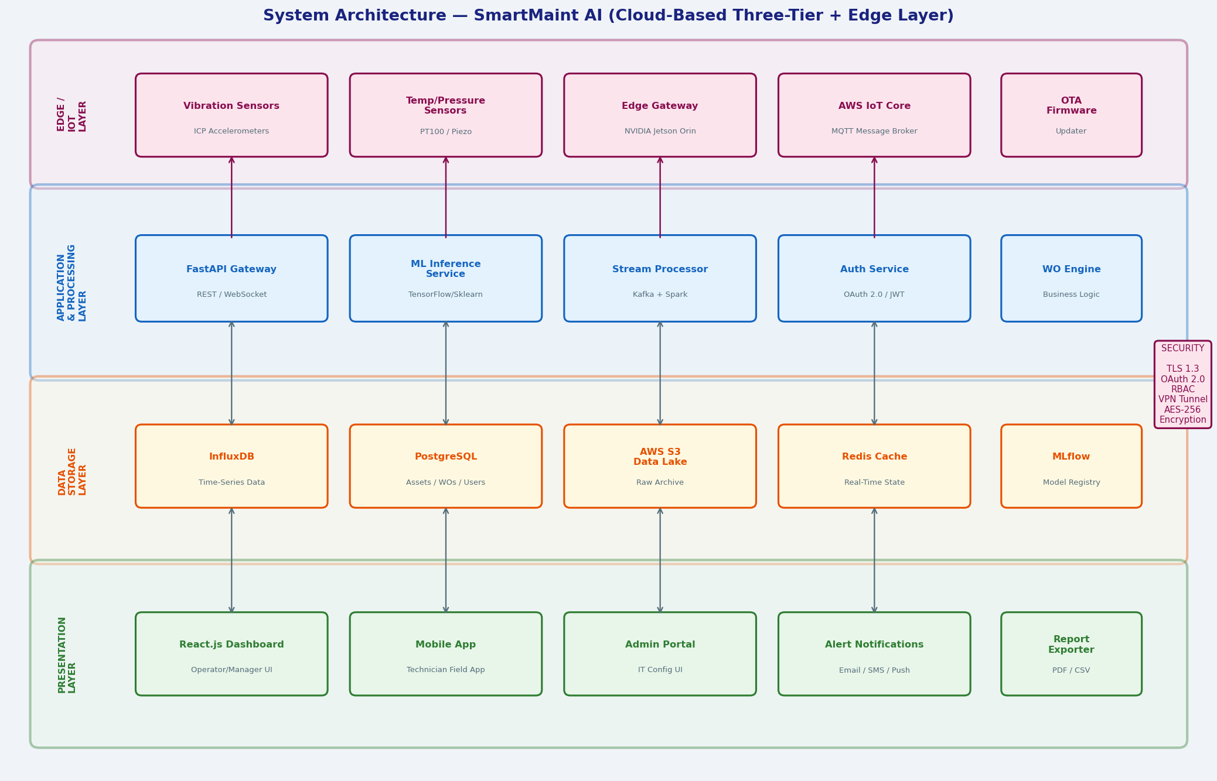
What is SmartMaint AI?
SmartMaint AI is a cloud-based platform that uses IoT sensors and machine learning to monitor industrial equipment in real time.
System Architecture Overview
Instead of waiting for machines to break or replacing parts on a fixed schedule, the system continuously watches for warning signs and predicts failures before they happen.
It automatically creates work orders, sends alerts to the right people, and gives everyone a dashboard tailored to their role.
Core Capabilities
✓
Real-time sensor monitoring
✓
ML failure prediction
✓
Automated work orders
✓
Role-based dashboards
✓
ERP/CMMS integration
✓
Historical reporting
4 / 10

Slide 5
System Requirements
Functional Requirements (Must Haves)
Non-Functional Requirements
FR-01
Collect live sensor data in real time (vibration, temp, pressure, RPM)
Performance
10K+ sensor readings/sec, <500ms latency
FR-02
Clean and process sensor streams within 500 ms
Availability
99.9% uptime — under 9 hours downtime/year
FR-03
Run ML models to detect anomalies and calculate health scores
Security
TLS 1.3, AES-256 encryption, OAuth 2.0 login
FR-04
Send alerts (Critical / High / Medium / Low) when issues are detected
Scalability
Support up to 50,000 sensors
FR-05
Auto-create work orders from high-severity alerts
ML Accuracy
≥85% precision, ≥80% recall
FR-06
Show role-specific dashboards for operators, techs, and managers
Usability
Dashboards learnable in under 2 hours
FR-07
Maintain a searchable asset and sensor registry
Maintainability
Microservices — update parts independently
5 / 10

Slide 6
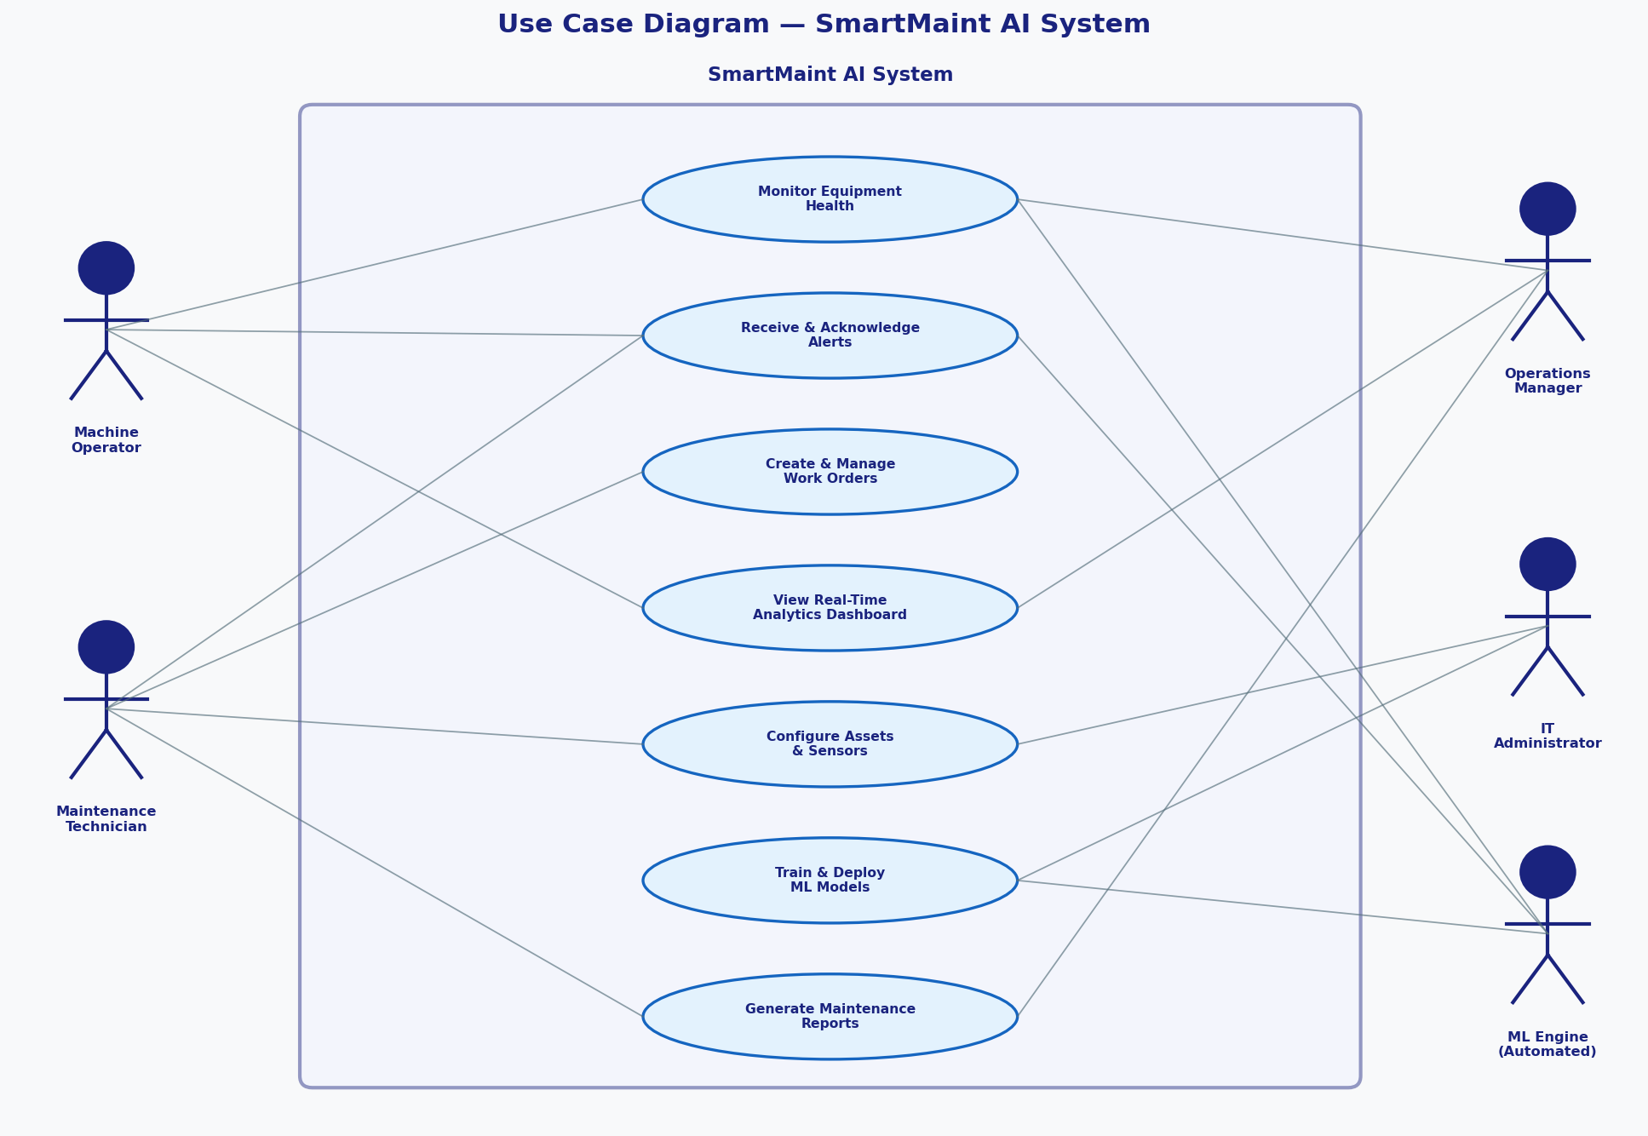
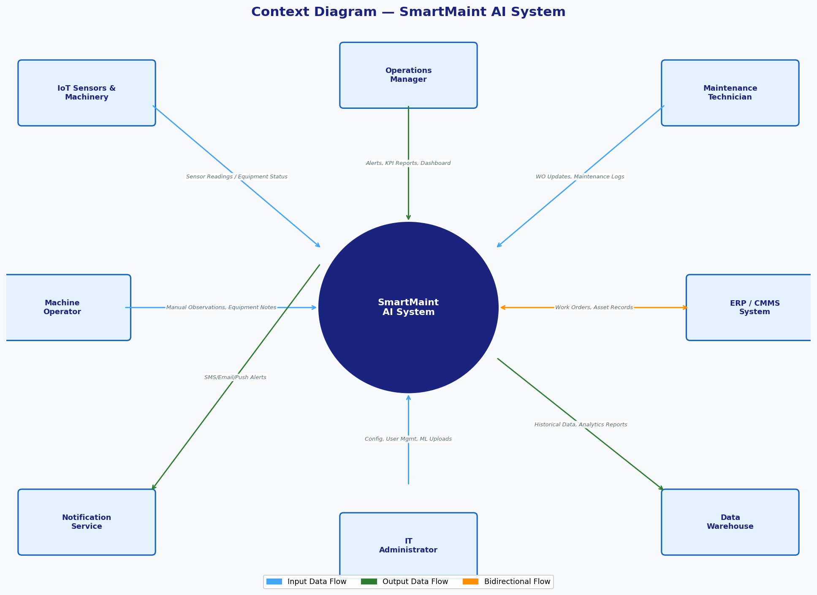
Process Modeling
Use Case Diagram
Context Diagram
5 actors · 7 use cases
SmartMaint AI as a black box with 8 external entities
6 / 10

Slide 7
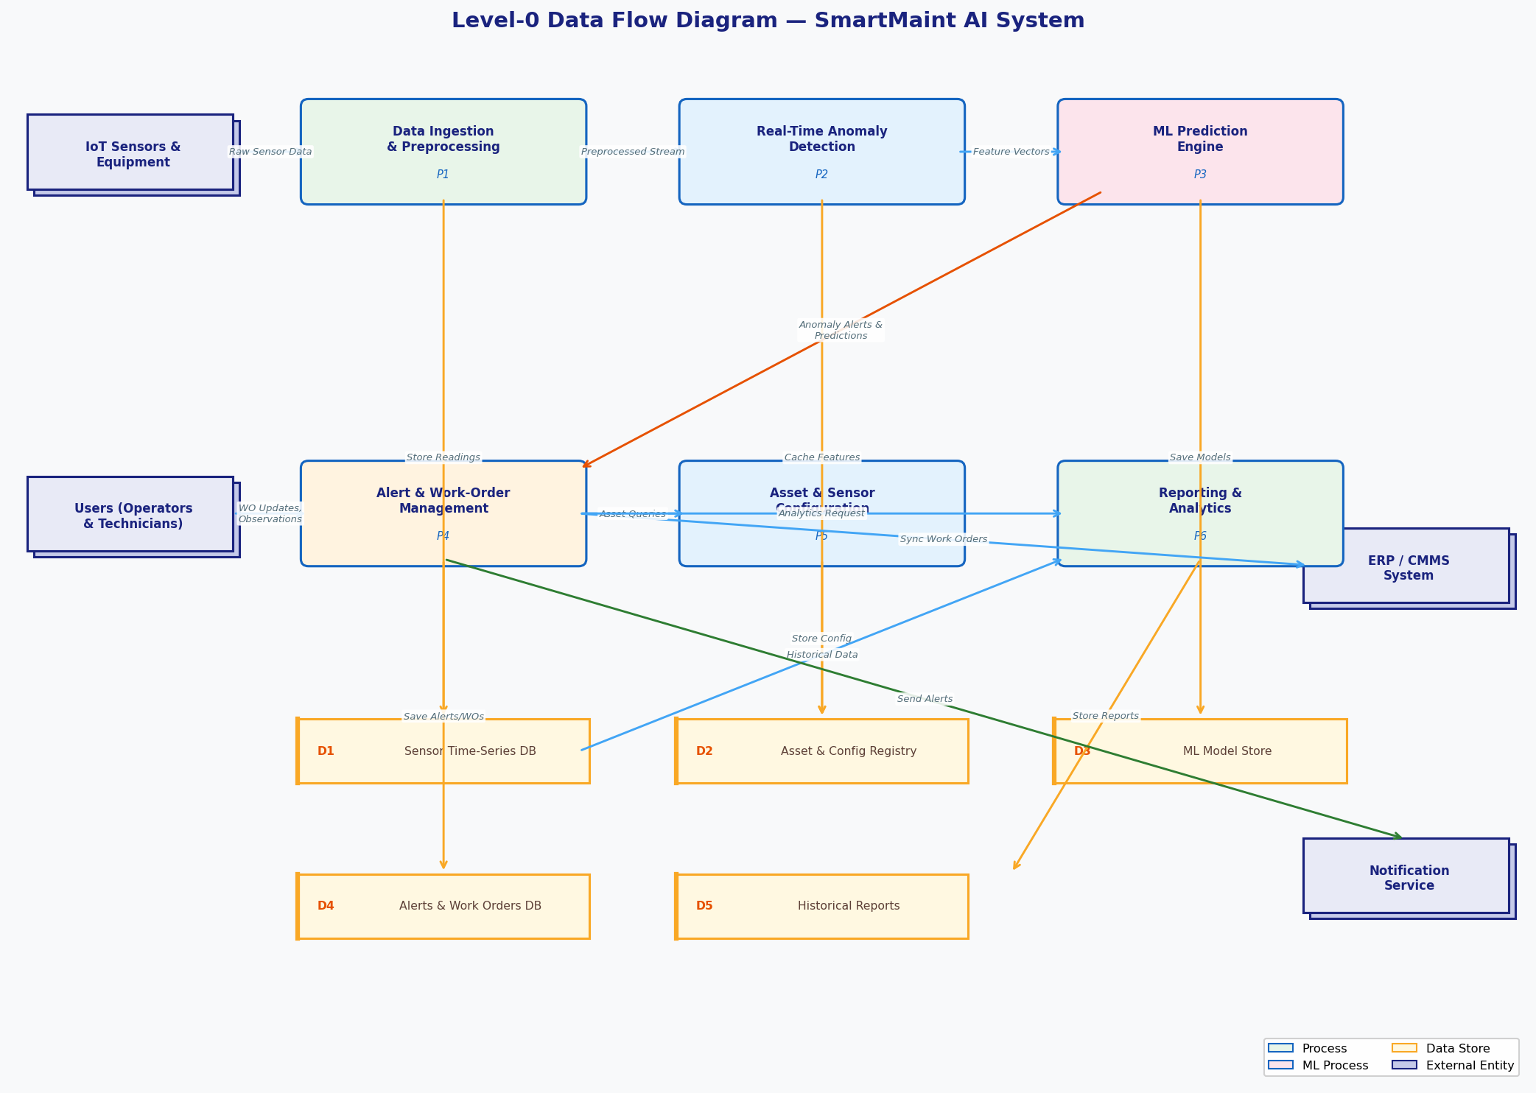
Level-0 Data Flow Diagram
The 6 Core Processes
P1
Data Ingestion
Takes in sensor data, cleans it, stores it
P2
Anomaly Detection
Flags unusual patterns in real time
P3
ML Prediction
Estimates failure probability per asset
P4
Alert & Work Orders
Creates tickets and notifies the right people
P5
Asset Config
Manage assets, sensors, users, thresholds
P6
Reporting
Generates scheduled and on-demand reports
7 / 10

Slide 8
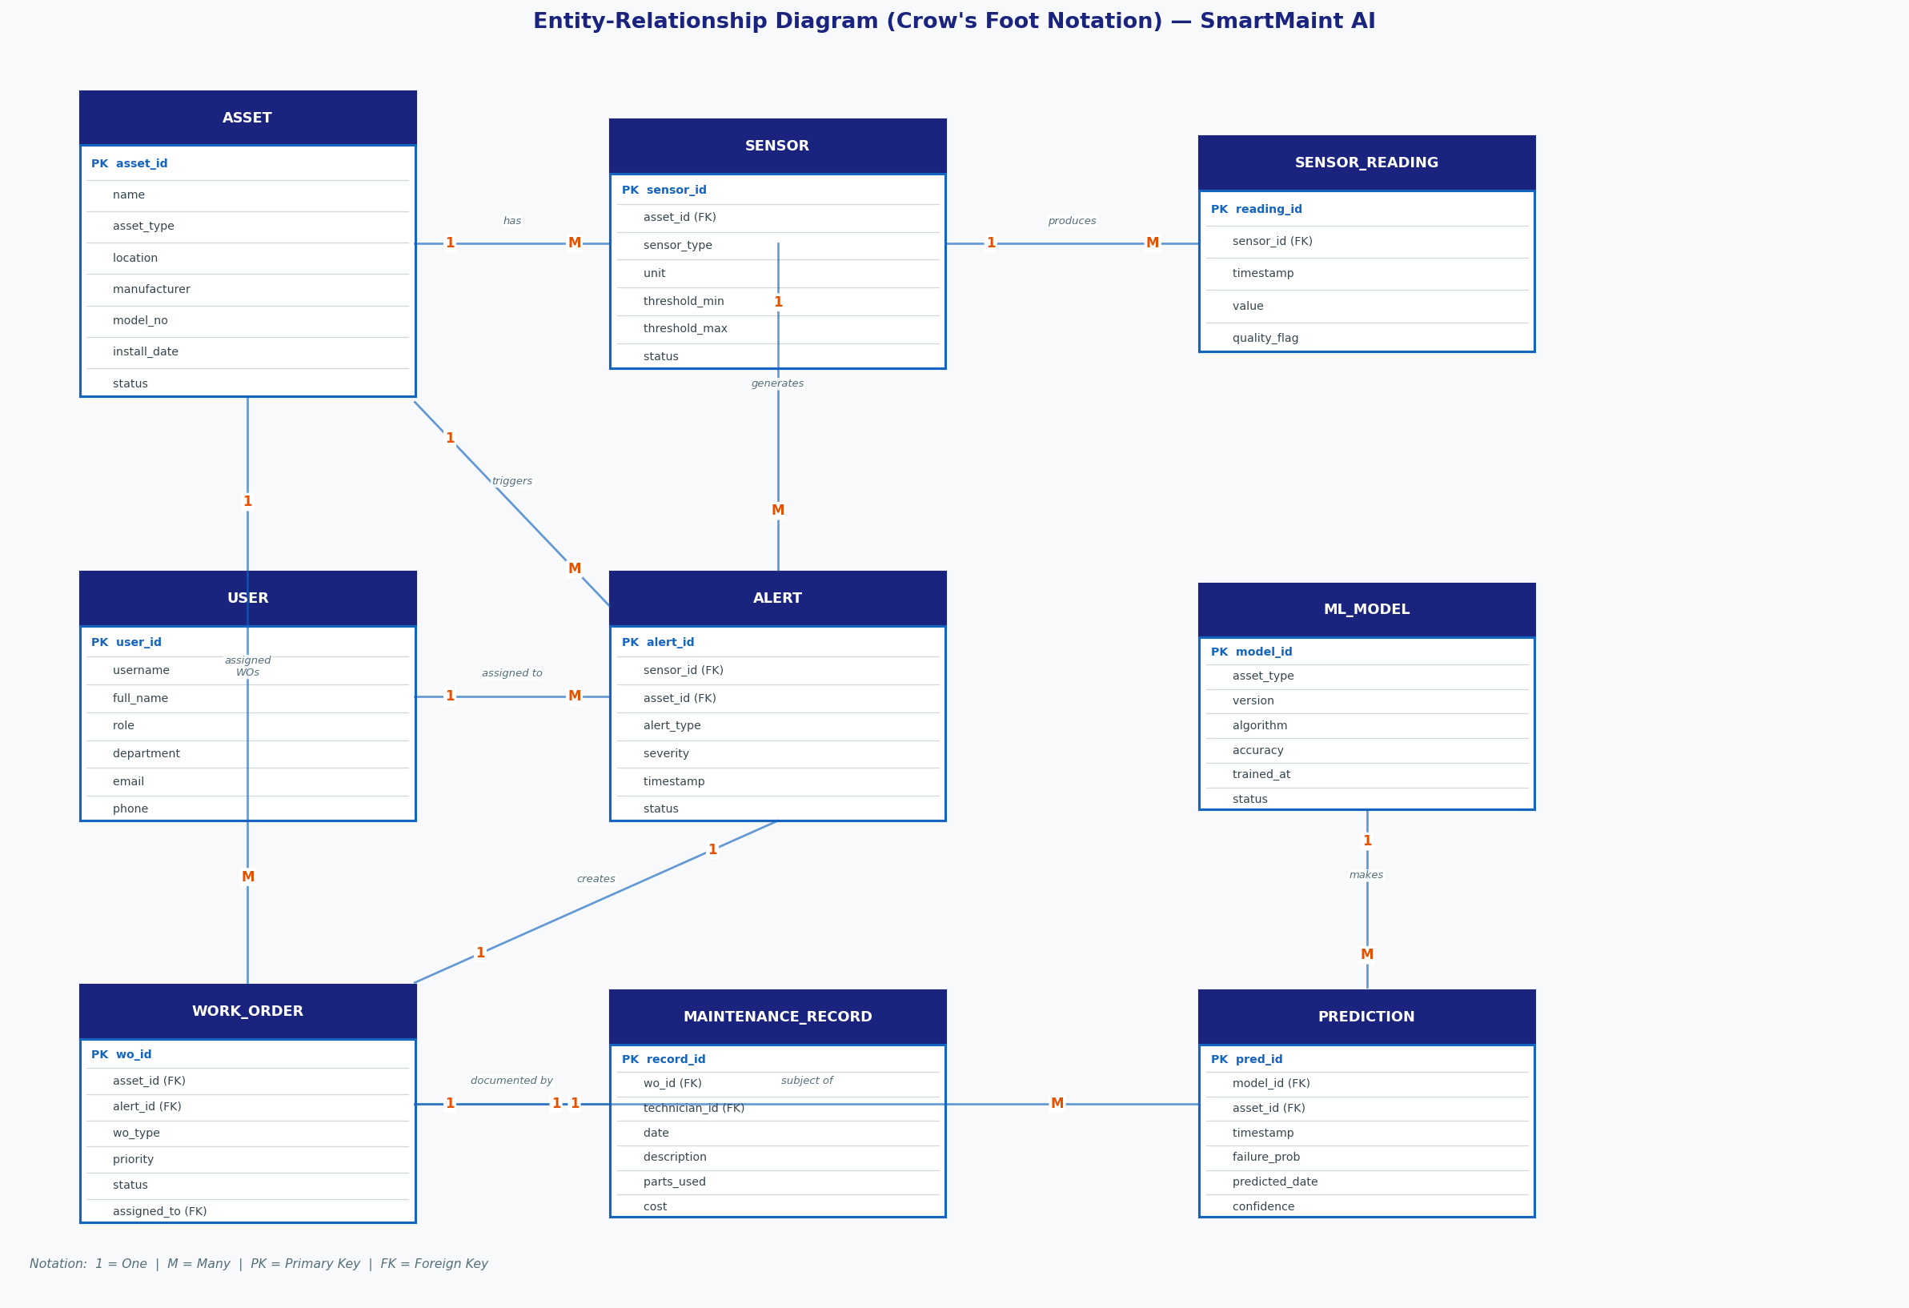
Data Modeling — Entity Relationship Diagram
Key Entities
ASSET
Machines and equipment
SENSOR
Measurement points on each asset
SENSOR_READING
Individual timestamped data points
ALERT
Anomaly notification with severity level
WORK_ORDER
Maintenance task assigned to a tech
MAINT. RECORD
Log of work done, parts, and cost
USER
Operators, techs, managers, admins
ML_MODEL
Versioned AI model with accuracy info
PREDICTION
ML output: failure probability & date
8 / 10

Slide 9
System Architecture
Architecture Layers
Edge / IoT
NVIDIA Jetson gateways + sensors
MQTT protocol · AWS IoT Core
Application
FastAPI · Kafka · Spark · ML inference
Docker + Kubernetes on AWS EKS
Data Storage
InfluxDB (time-series) · PostgreSQL
S3 archival · Redis cache · MLflow
Presentation
React.js web dashboard
React Native mobile app
9 / 10

Slide 10
Conclusions & Next Steps
Expected Benefits
40–50%
20–30%
15–25%
60–70%
12–18mo
Less
unplanned
downtime
Lower
maintenance
costs
Longer
equipment
lifespan
Fewer
emergency
repairs
ROI
payback
period
Implementation Challenges
3-Phase Rollout
1
Older machines may need sensors retrofitted
Phase 1 — Pilot
Months 1–3
1 line, 10–20 machines. Install sensors, build initial models.
2
ML models need labelled historical failure data
Phase 2 — Expand
Months 4–9
3
Staff training and change management required
3–5 lines. ERP integration. Refine models on live data.
4
Legacy ERP integration may need custom work
Phase 3 — Full
Months 10–18
Whole facility. Executive dashboards. Measure ROI.
10 / 10

